Slide 1
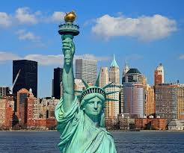

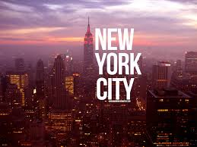
Flat Stanley’s Trip to
New York
USA

Slide 2
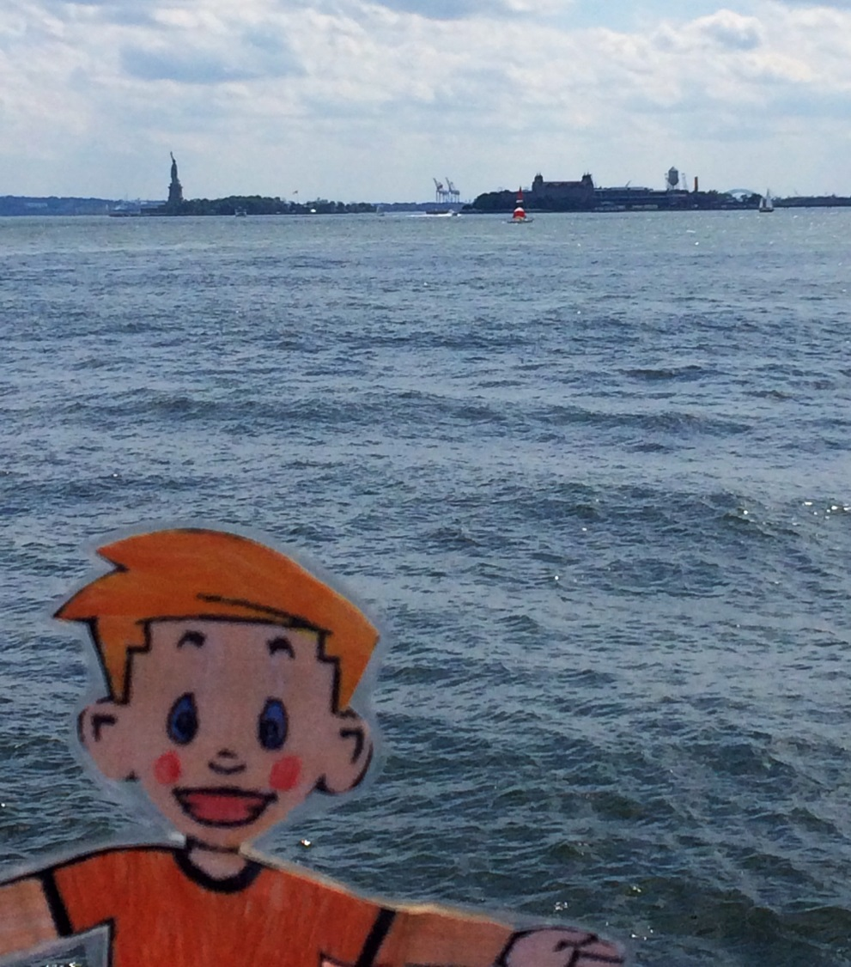
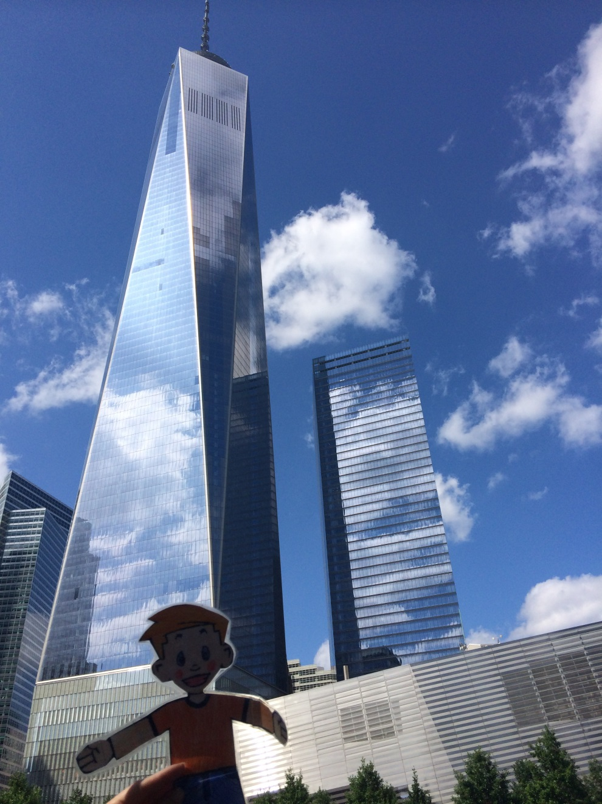
Flat Stanley looking at the Statue of Liberty
Flat Stanley looking at the
One Wold Trade Centre

Slide 3
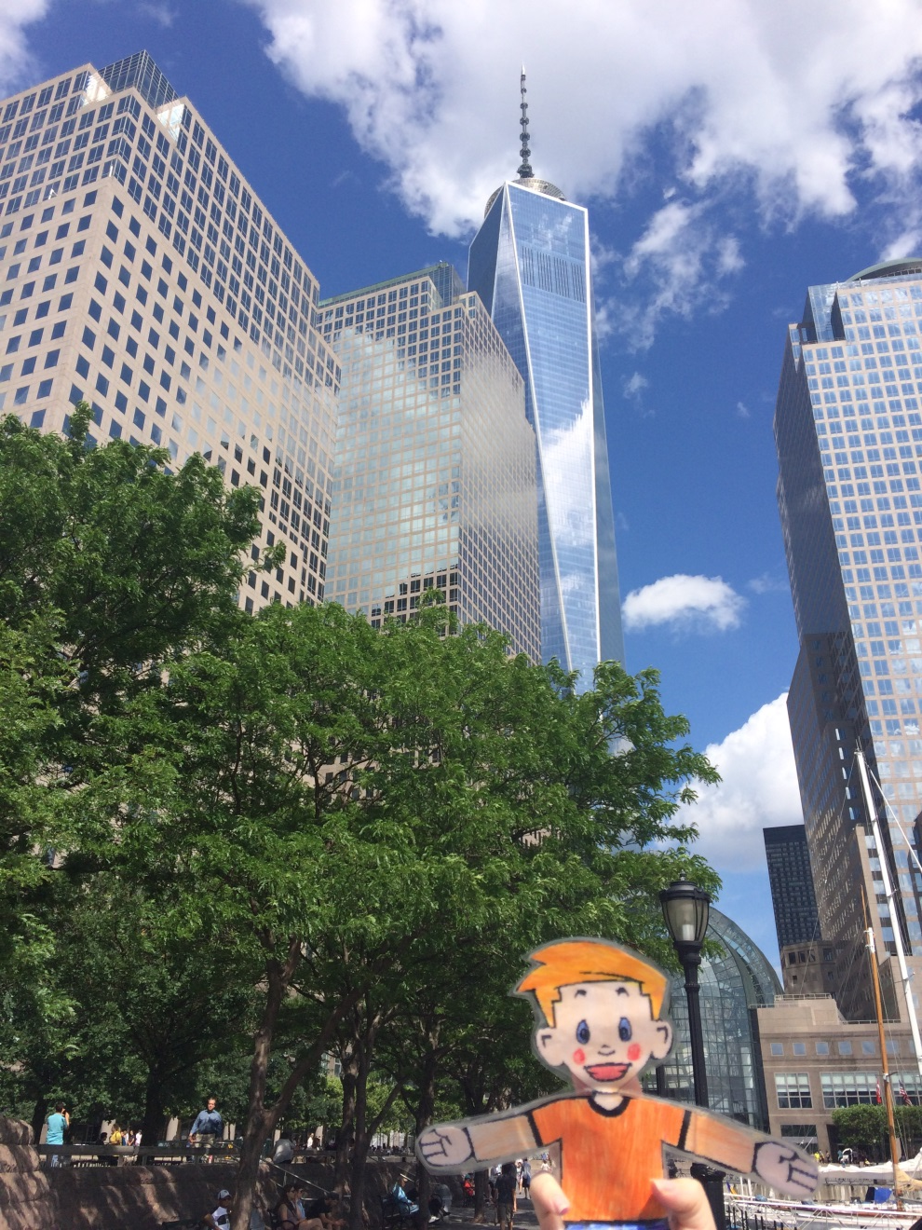
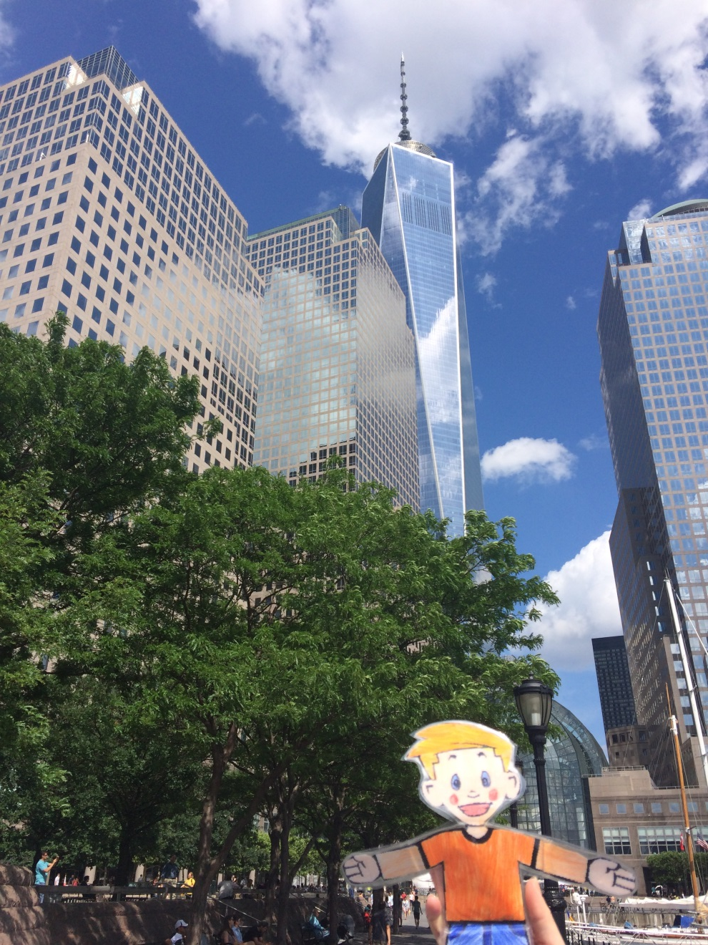
Flat Stanley looking at the One Wold Trade Centre

Slide 4
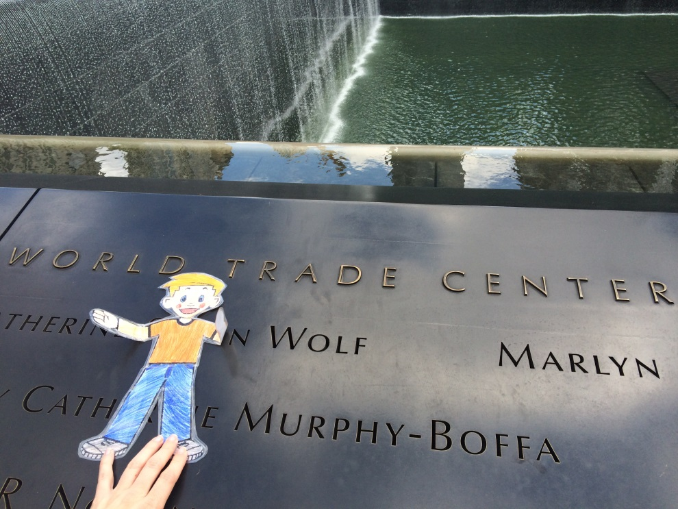
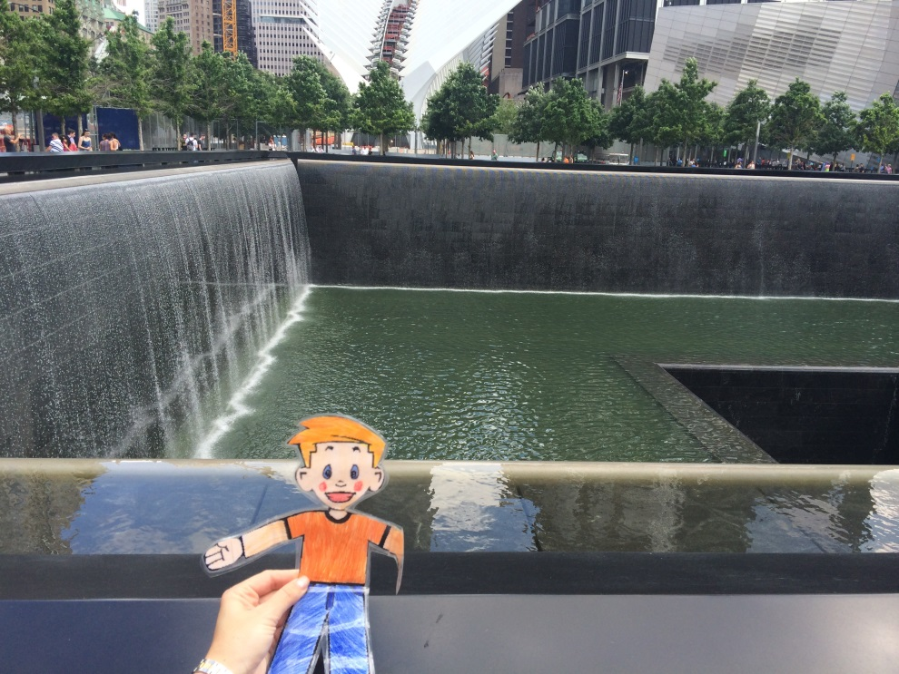
Flat Stanley at World Trade Centre Memorial

Slide 5
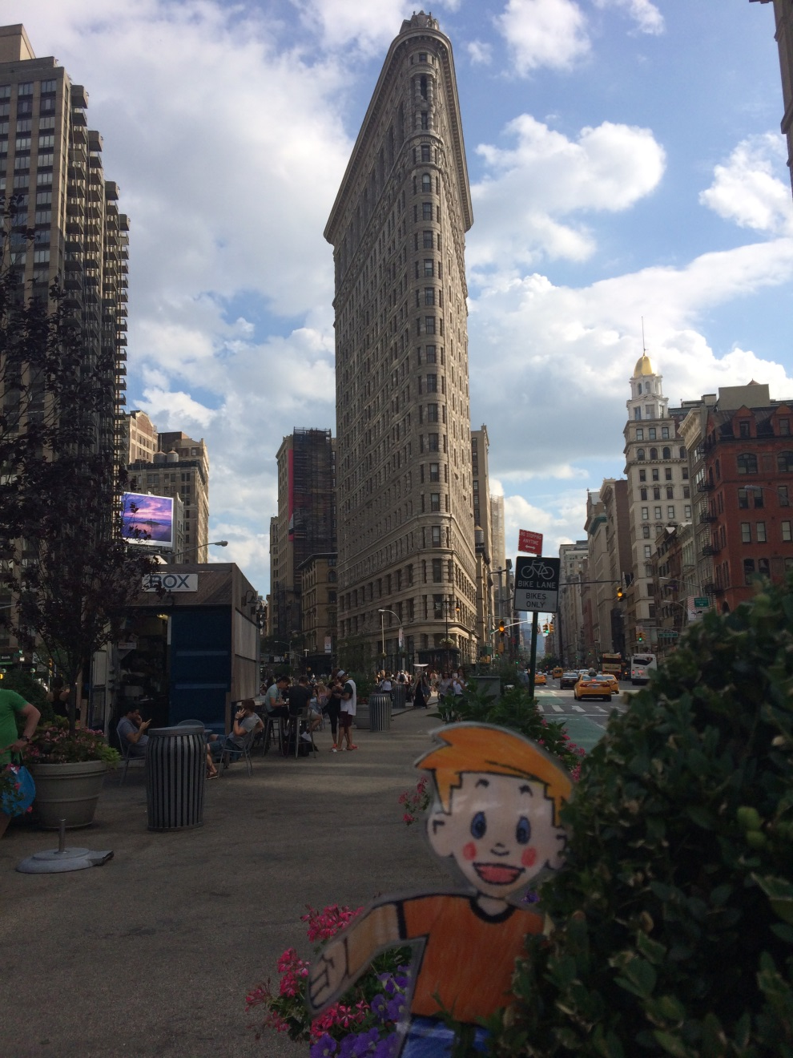
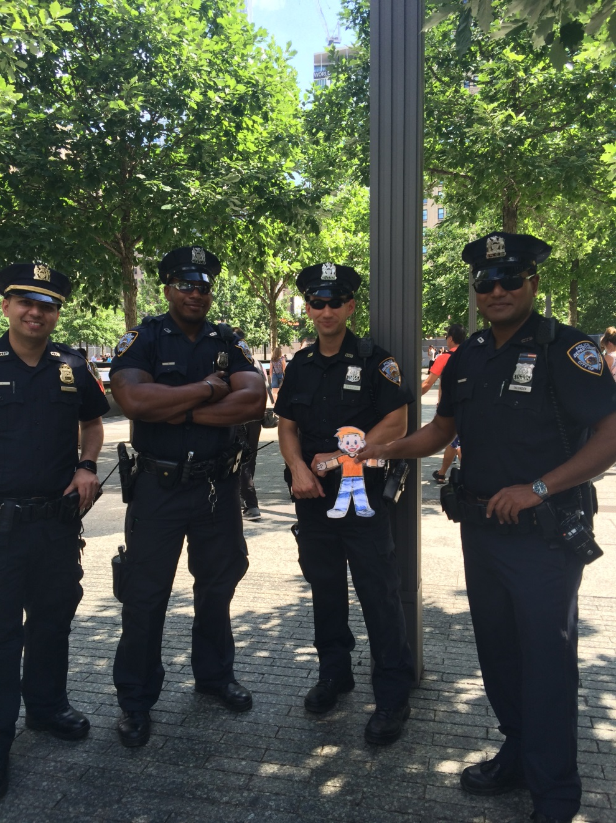
Flat Stanley at Flatiron Building
Flat Stanley with New York’s Police

Slide 6
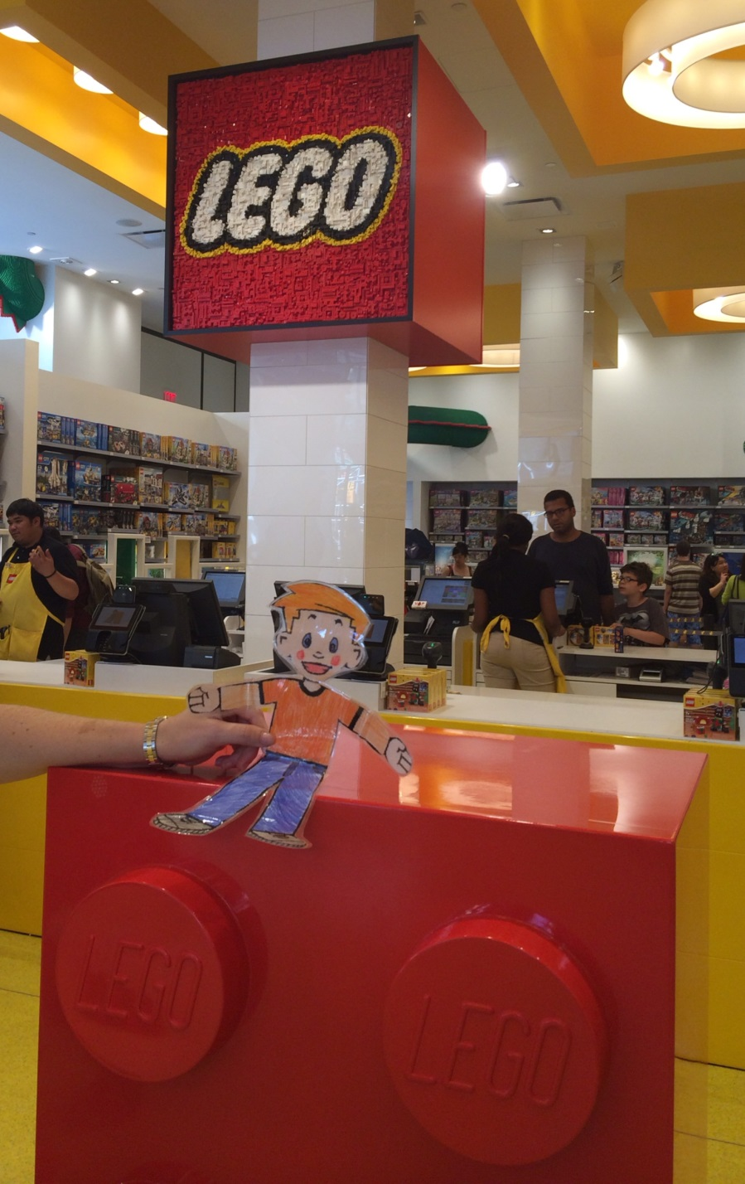
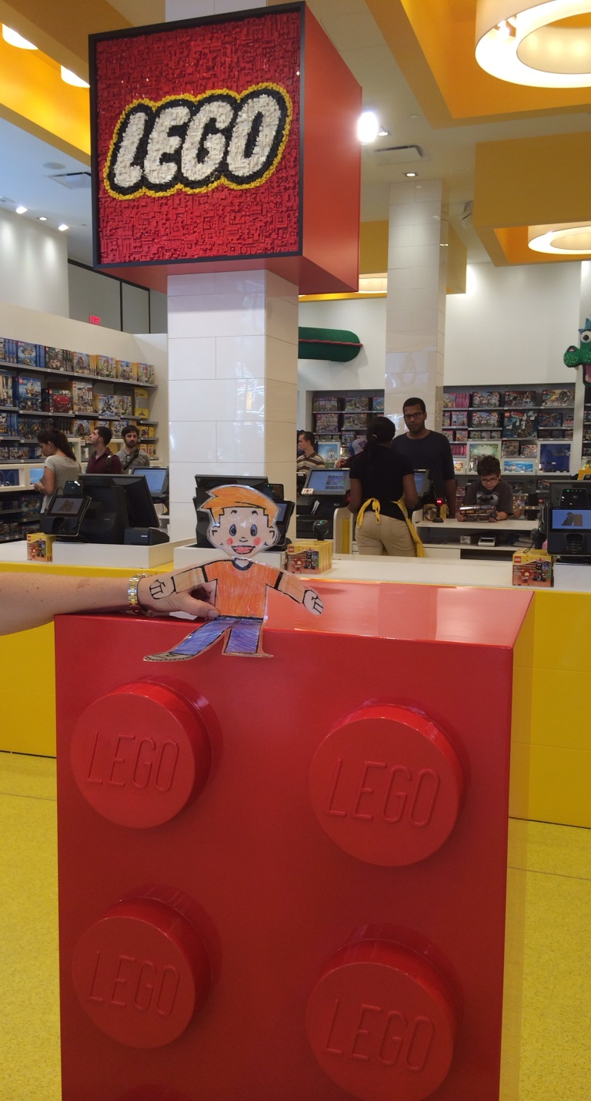
Flat Stanley at Legoland

Slide 7
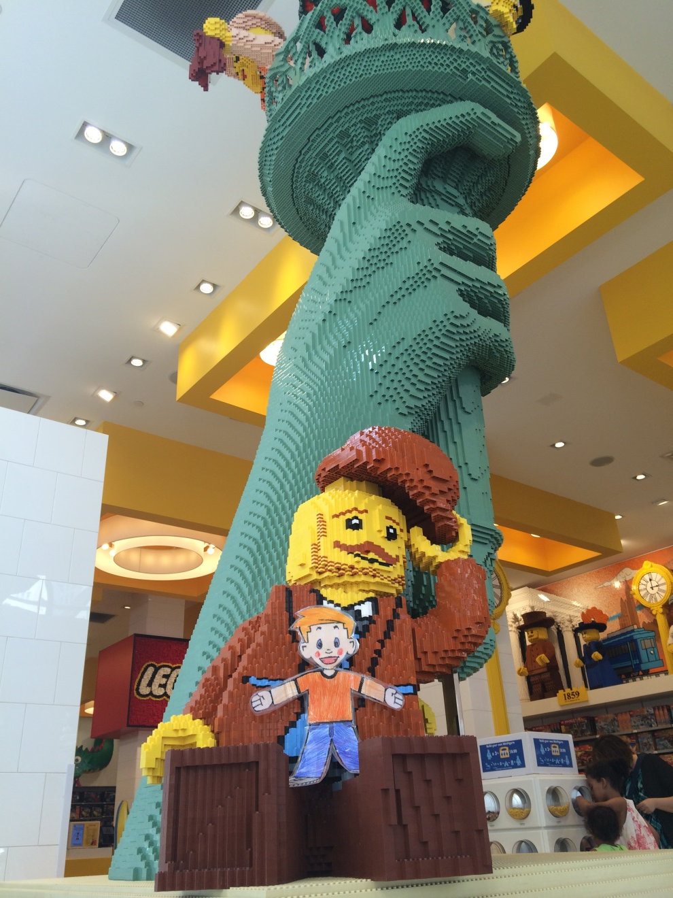
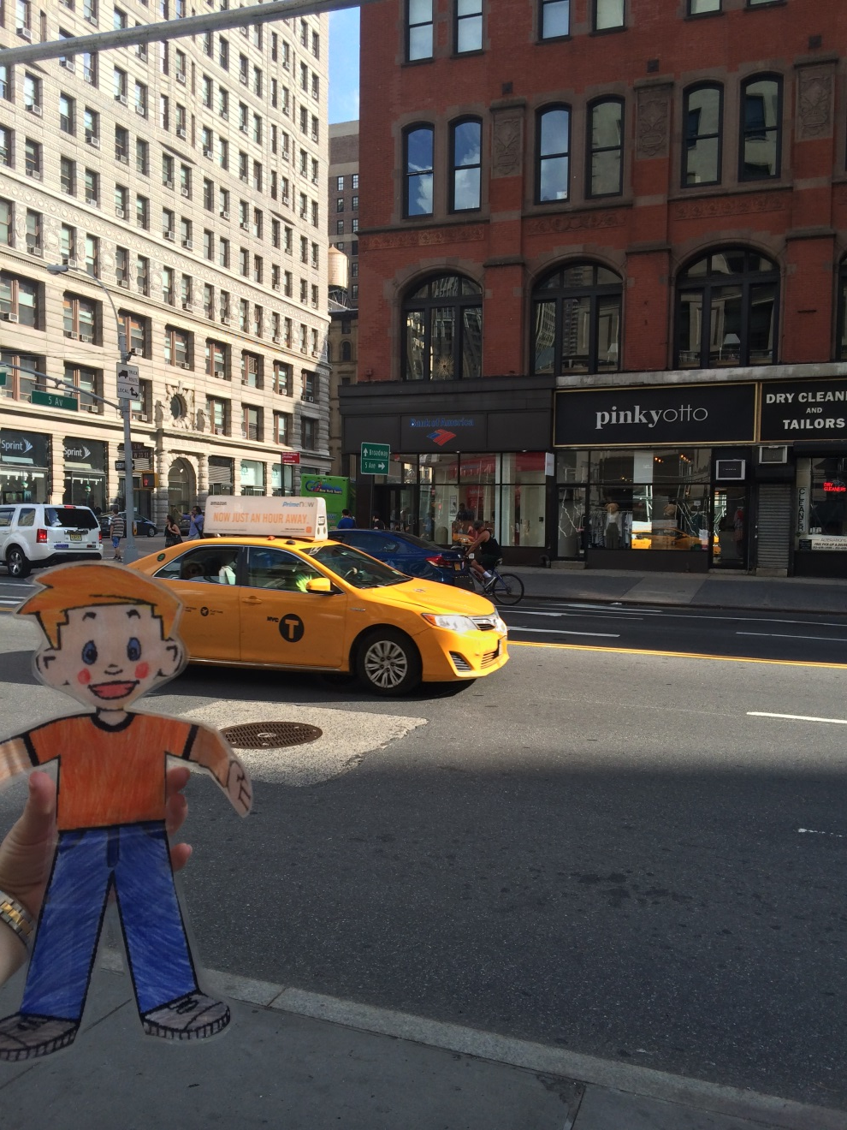
Flat Stanley at Legoland
Flat Stanley looking at New York Yellow Taxi

Slide 8
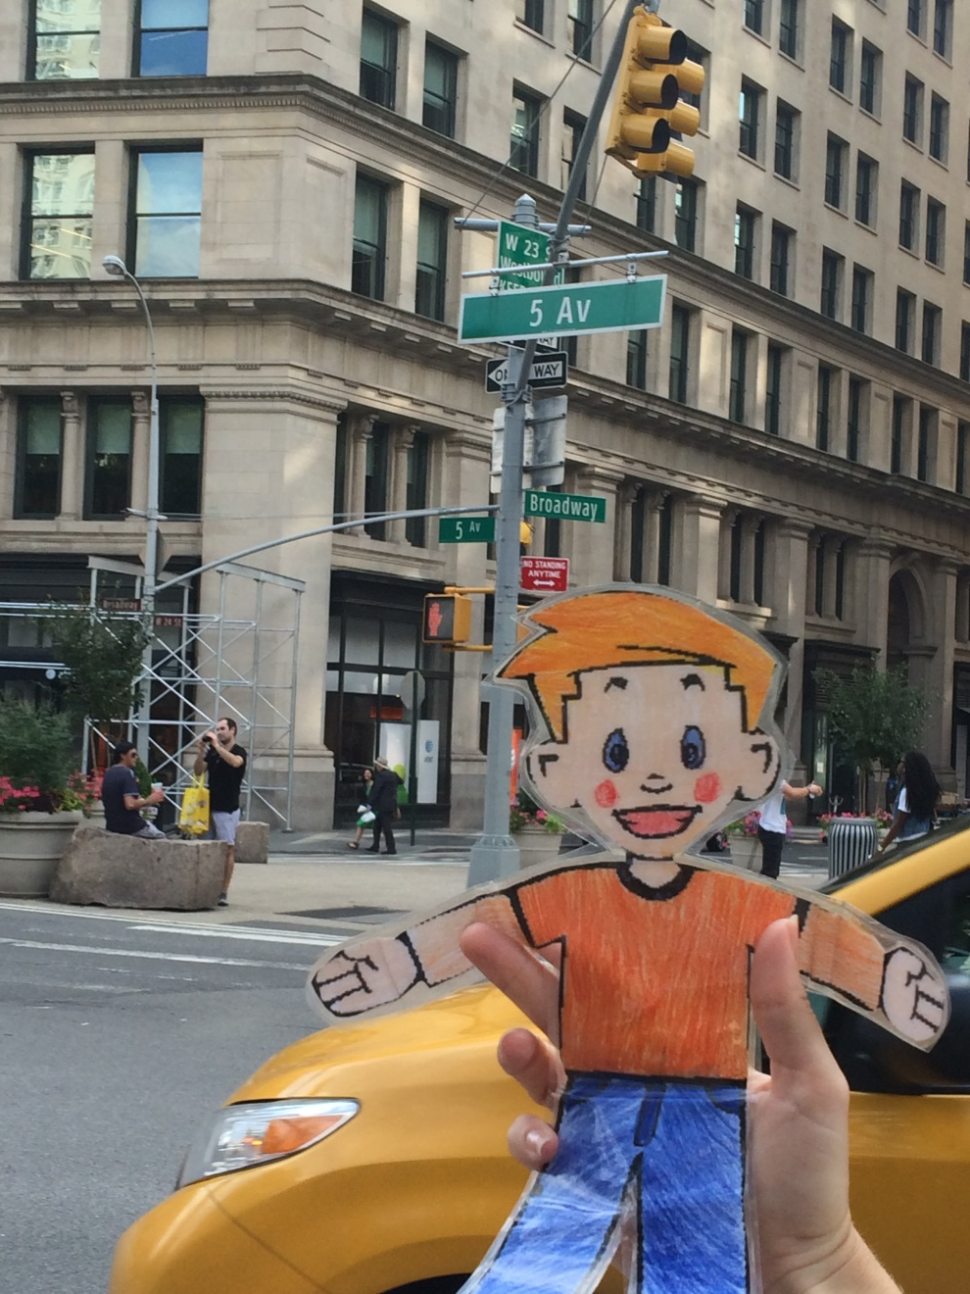
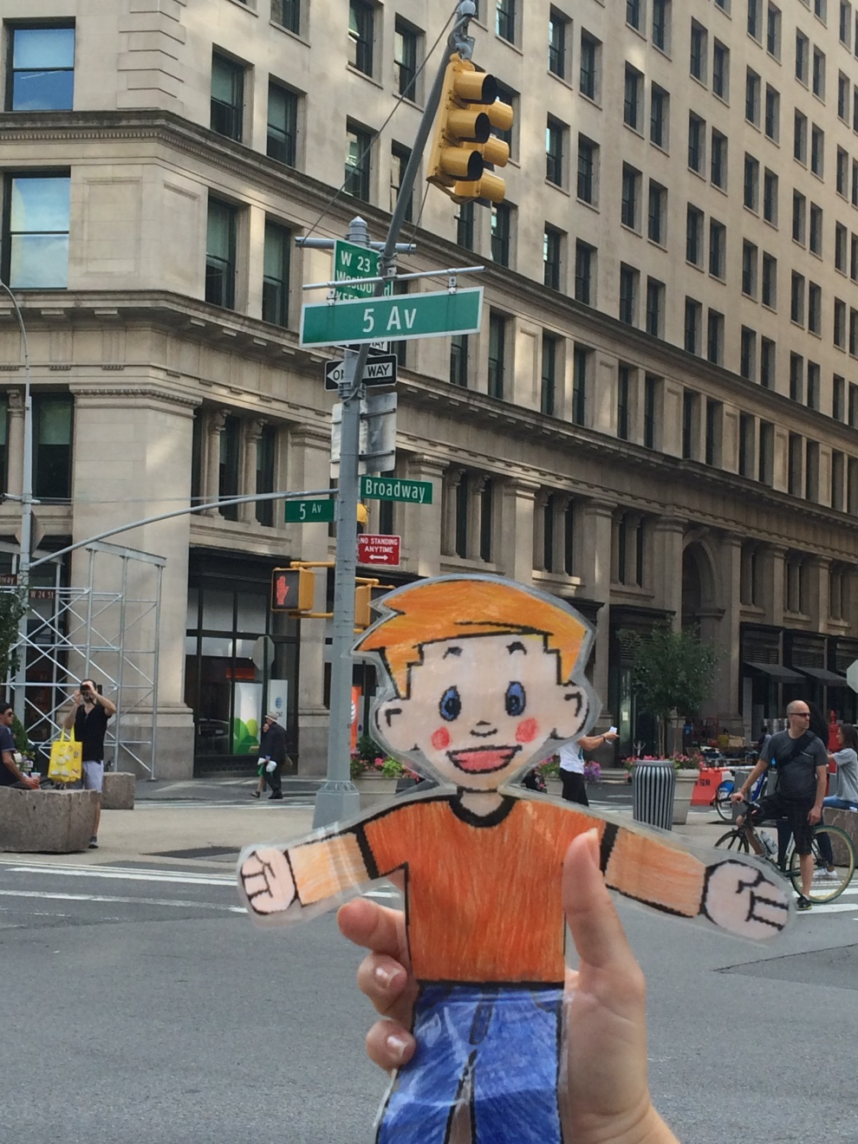
Flat Stanley at cnr 5th Ave & Broadway – New York Street & Traffic Lights

